Slide 1
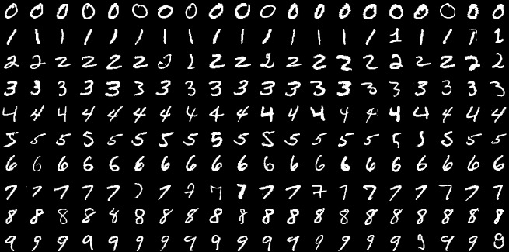
Handwritten Digit Recognition using CNN
By: Manav Taparia, Techno India University

Slide 2


Unravelling Handwritten Digits
The core objective of this project is to develop a robust system capable of accurately identifying handwritten digits, transforming complex patterns into actionable insights.
The MNIST Dataset: A Foundation for Innovation
Impactful Real-World Applications
Beyond academic research, this technology drives practical solutions, enhancing efficiency and accuracy across various industries.
This foundational dataset is the bedrock of handwritten digit recognition research, providing a rich training ground for advanced algorithms.
Automated Postal Services: Revolutionizing mail sorting through precise recognition of handwritten postal codes.
70,000 Greyscale Images: A massive collection of single handwritten digits, forming the standard benchmark.
Enhanced Optical Character Recognition (OCR): Powering advanced document processing, from digitizing historical texts to modern archiving.
28x28 Pixel Precision: Each image meticulously captured to allow for detailed analysis and feature extraction.
Streamlined Data Entry: Automating form processing and significantly reducing manual effort and errors in diverse sectors.
Benchmarking Standard: Widely adopted for evaluating and pushing the boundaries of classification algorithms in computer vision.

Slide 3
Preparing the Data for Intelligence
Effective data preprocessing is crucial for optimal model performance and accurate digit classification.
Normalization
1
Pixel values, initially ranging from 0-255, are scaled down to 0-1. This standardisation aids in faster and more stable training of the neural network.
2
Reshaping
Images are reshaped into a 28x28x1 format. The '1' signifies a single channel for greyscale images, preparing them for Convolutional Neural Network (CNN) input.
Train/Validation Split
3
The dataset is strategically divided into training and validation sets. This split allows the model to learn from a subset of data and evaluate its generalisation ability on unseen data.

Slide 4
Crafting the Convolutional Neural Network
Our CNN architecture is designed to extract intricate features from handwritten digits, enabling precise classification.
Layer Breakdown
Conv2D Layers
MaxPooling Layers
Feature extraction through convolutional filters.
Down-sampling to reduce dimensionality and computational load.
Flatten Layer
Dense Layers
Converts the 2D feature maps into a 1D vector.
Fully connected layers for high-level reasoning and classification.
Dropout Layer
Softmax Activation
Prevents overfitting by randomly setting a fraction of input units to 0 at
each update during training.
Outputs probability distribution across the 10 digit classes.
Optimization & Loss
Adam Optimizer
Sparse Categorical Crossentropy
An adaptive learning rate optimisation algorithm, ideal for efficient convergence.
The chosen loss function, suitable for multi-class classification when labels are integers.

Slide 5
Training and Validating the Model
The model undergoes iterative training to refine its learning and enhance predictive accuracy.
Epochs & Batch Size
Accuracy Progression
Dropout for Overfitting
Trained over 10 epochs, with a batch size of 128. This balance ensures efficient learning without exhausting computational resources.
Witnessing a consistent improvement in accuracy with each epoch, indicating effective learning from the training data.
The judicious application of dropout layers significantly reduces the risk of overfitting, ensuring the model generalises well to new data.

Slide 6
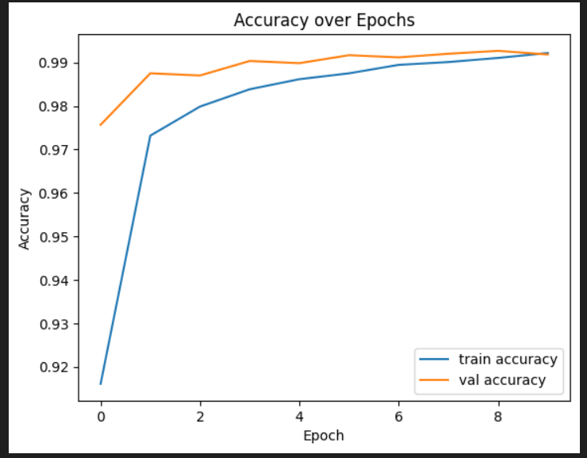
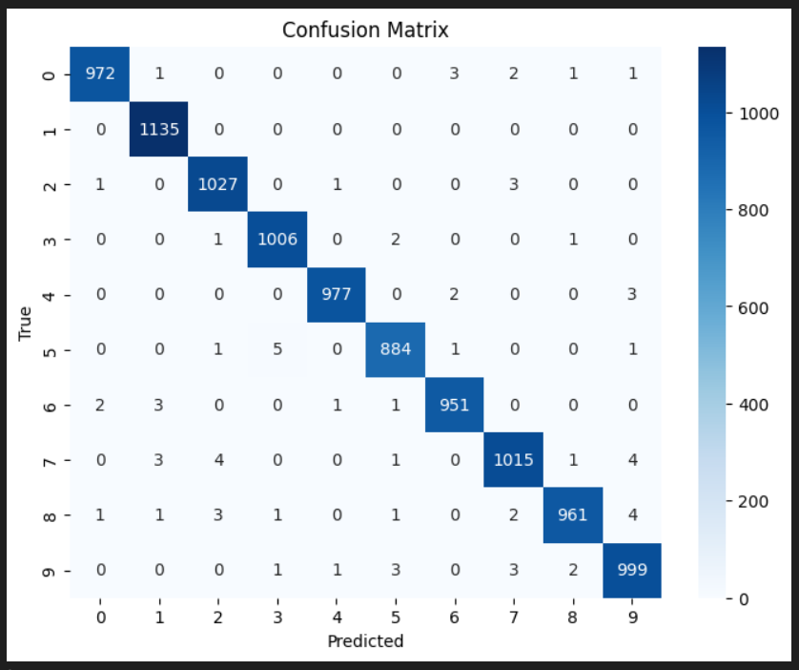
Performance Metrics and Visualisations
The model demonstrates exceptional performance in distinguishing handwritten digits, supported by key metrics and visual insights.
Accuracy over Epoch
Confusion Matrix
The trained CNN achieves a remarkable final accuracy of approximately 98-99 percent on the validation dataset, showing consistent improvement during training.
A confusion matrix clearly illustrates the model's performance, highlighting which digits are often confused with others and revealing areas for refinement.

Slide 7
Conclusion
Built a CNN-based system that accurately reads handwritten digits from a JPEG image.
Added custom preprocessing (thresholding, contour detection, padding, centering) to handle multi-digit sequences, not just single digits.
System works well for clear spacing and clean handwriting but performs worse with overlapping digits, extreme noise, or handwriting styles very different from MNIST.

